Slide 1
Time-of-Use Transition Michael Hyams, Assistant Deputy Manager for Power -- CleanPowerSF

Slide 2
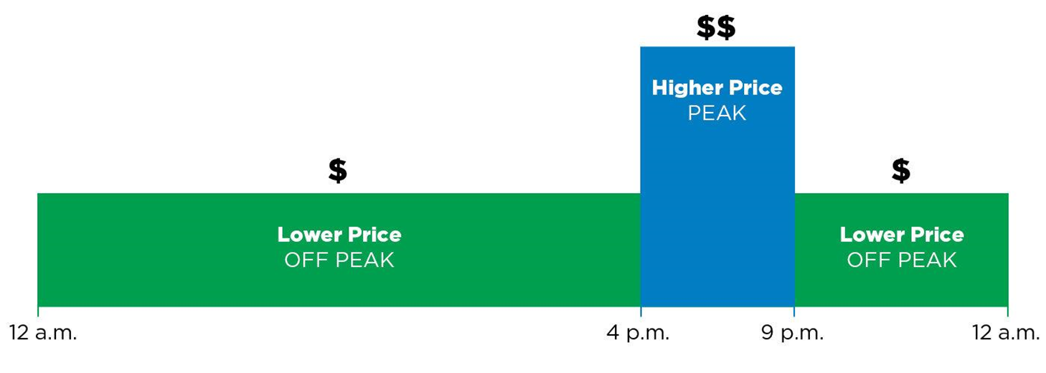
What is Time-of-Use?
Time-of-Use (TOU) rates help maximize the benefits of renewable energy on the electric grid
Under TOU pricing, when you use electricity is just as important as how much electricity you use
TOU encourages electricity use during times of the day when energy is cheapest and cleanest
The default E-TOU-C rate has peak pricing 4-9 pm everyday, and lower rates all other hours

Slide 3
Time-of-Use Transition
The San Francisco Public Utilities Commission (SFPUC) approved a plan to transition CleanPowerSF customers to the E-TOU-C rate and provide 12-months of bill protection.
At any time, customers could choose to return to the E-1 flat rate, or select an alternative TOU rate
Customers received various messaging before and during the 12-month transition period, and were shown on each bill how they were performing
Customers who remained on the E-TOU-C rate for 12 months were provided bill protection
E-TOU-C is now the default rate

Slide 4
Post-TOU Transition Bill Impacts
Customer Type | # of Customers | Avg. Customer Bill Impact (Annual) | Billed Revenue Impact
Non-Benefiter | 88 | ↑$19.18 | ↑$1,681
Neutral | 59,874 | ↓$5.29 | ↓$318,877
Benefiter | 82,830 | ↓$23.46 | ↓$1,963,622
Total | 142,792 |  | ↓$2,284,180
Non-Benefiter – Customers paid >$10 more on E-TOU-C rate compared to E-1 rate over 12-month period. Bill Protection credit applied.
Neutral – Customers net bill difference was less than or equal to $10 over 12-month period.
Benefiter – Customers saved >$10 on E-TOU-C rate compared to E-1 rate over 12-month period

Slide 5
Residential Customers by Rate Type

Slide 6
Questions?

Slide 7
Appendix

Slide 8
PG&E Service Territory Transition Summary
Res TOU Transition Status | Count | % of Total
Transitioned Population | 1,612,538 | 100%
Remain on TOU-C | 1,375,653 | 85.31%
Switch to Different TOU | 20,271 | 1.26%
Switch back to E-1 | 22,625 | 1.40%
Stopped/Closed Service Agreement | 193,989 | 12.03%

Slide 9
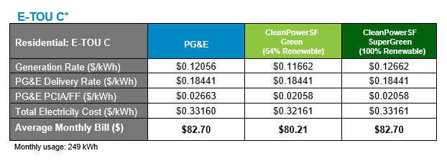
Bill Comparison – E-TOU-C as of July 1, 2022

